Slide 3
上课内容：自然拼读
上课时间：每周六晚19：00 - 20：30
上课老师：尹岩老师

Slide 4
A is for apple [æ] [æ] [æ]
B is for bat [b] [b] [b]
C is for cat [k] [k] [k]
D is for dog [d] [d] [d]
E is for elephant [e] [e] [e]
F is for frog [f] [f] [f]
G is for girl [g] [g] [g]

Slide 5
Hh
字母读音： [eit∫]
字母发音： [h]

Slide 6
H is for head [h] [h] [h]
hen
hat
house

Slide 7
I i
字母读音： [ai]
字母发音： [i]

Slide 8
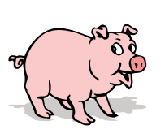
I is for it [i] [i] [i]
pig
milk
fish

Slide 9
J j
字母读音： [dʒei]
字母发音： [dʒ]

Slide 10
J is for jeep [dʒ] [dʒ] [dʒ]
jacket
juice
jeep

Slide 11
Kk
字母读音： [kei]
字母发音： [k]

Slide 12
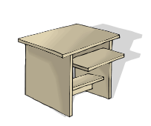
K is for kite [k] [k] [k]
book
key
desk

Slide 14
L l
字母读音： [el]
字母发音： [l]

Slide 15
L is for lion [l] [l] [l]
lion
seal
look

Slide 16
Mm
字母读音： [em]
字母发音： [m]

Slide 17
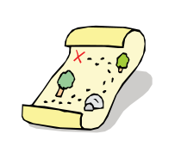
M is for monkey [m] [m] [m]
moon
milk
map

Slide 18
Nn
字母读音： [en]
字母发音： [n]

Slide 19
N is for nose [n] [n] [n]
nine
nest
nose

Slide 20
H is for head [h] [h] [h]
I is for it [i] [i] [i]
J is for jug [dʒ] [dʒ] [dʒ]
K is for kite [k] [k] [k]
L is for lion [l] [l] [l]
M is for monkey [m] [m] [m]
N is for nose [n] [n] [n]

